Slide 1
Partition-based scheduling
Multicore Systems

Slide 2
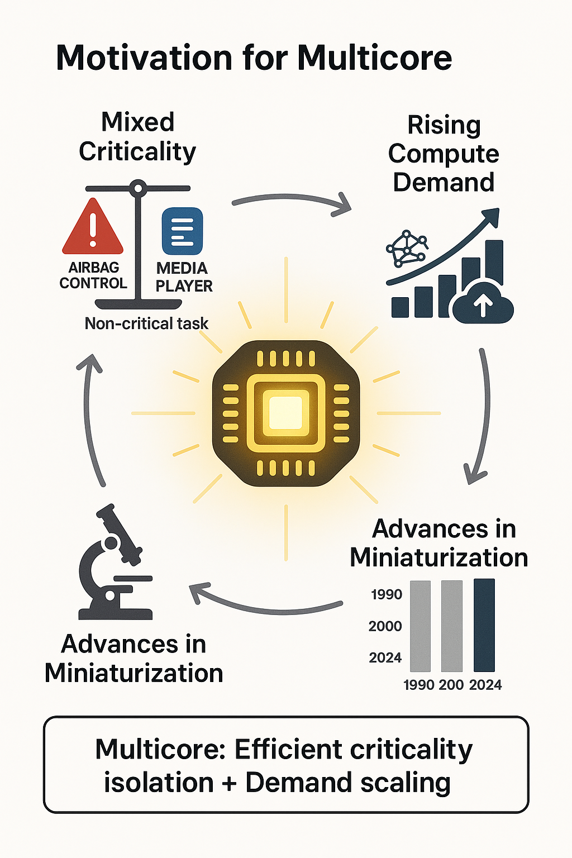
Motivation
Advantages:
Task isolation and mututal interference [2].
Parallel task execution [4].
Enhances energy efficieny.
Higher bandwidth [6].
Lower communication latency [5].
Fig. 1: Motivation for multi-core systems [8].

Slide 3
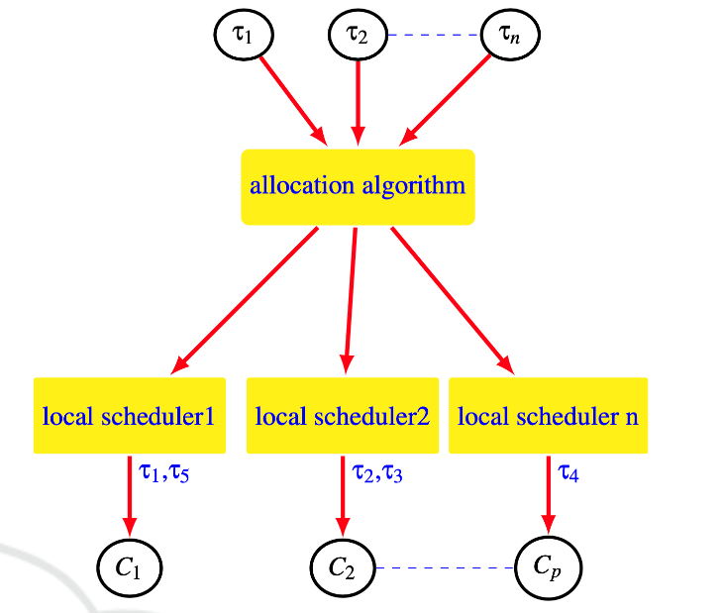
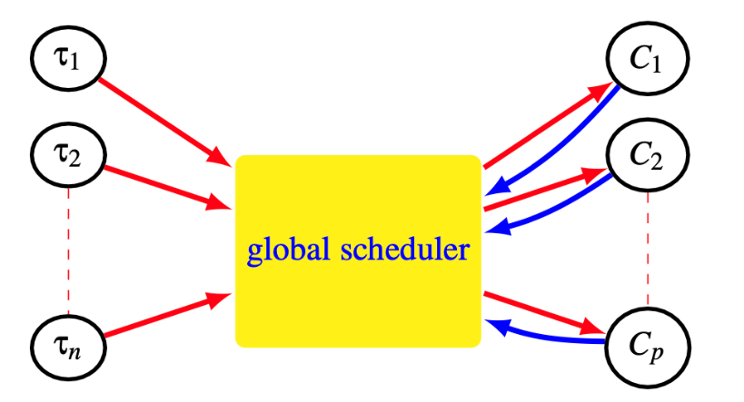

Scheduling multi-core systems
Two fundamental approaches:
Global Scheduling: Task may execute on any core and migration is allowed.
Partition-based scheduling: Tasks statically assigned to cores.
Fig. 2: Global Scheduling [7].
Fig. 3: Parition-based scheduling [7].

Slide 4
Proposed strategy
Goal: Reduced Communication Cost between cores.
Partitioning algorithm: Clustering-based.
Scheduling algorithm: Earliest Deadline First (EDF).
Fig. 6: Proposed strategy and goal.

Slide 5
Partitioning Model
$$for all tasks$$
Cluster Search
${Cost}_{C_{k},C_{l}}$ = X
$U_{C_k}$ < $U_{C_j}$
Cluster formed
Assigning Core
$U_{C_k}$ <= 1
Start Scheduling
Updating utilization
Core Assigned

Slide 6
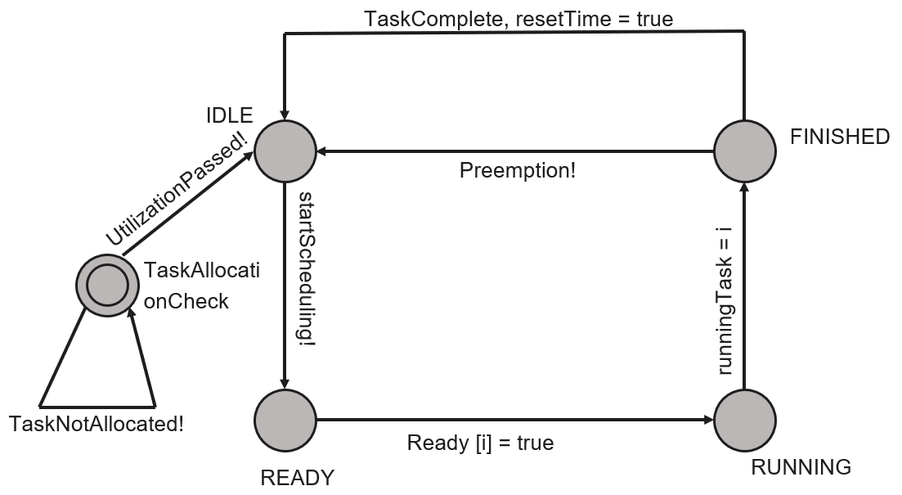
Scheduling Model
Fig. 8: Modelling of scheduler

Slide 7
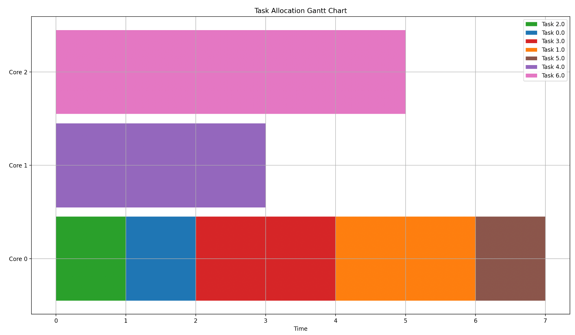
Implementation and Example
Fig. 7: Task dependency matrix

Slide 8
Overview and Conclusion
Partition-based scheduling on multi-core systems is discussed.
Implementation in C withFreeRTOS (Repository).
Simulation illustrated in UPPAAL.
Tasks with frequent communication formed cluster.
Clusters allocated on nearby cores, with schedulability constraints.
Communication cost reduced.

Slide 9
References
[1] Juan Zamorano and Juan Antonio de la Puente. “On real-time partitioned multicore systems”. In: ACM SIGAda Ada Letters 33 (Nov. 2013), pp. 33–39. DOI: 10.1145/2552999.2553003.
[2] C Buttazzo. Hard Real-time Computing Systems: Predictable Scheduling Algorithms and Applications. Springer, 2011.
[3] Yang Pan et al. “The research of multi-core parallel technology”. In: 2012 8th International Conference on Natural Computation. 2012, pp. 1056–1059. DOI: 10. 1109/ICNC.2012.6234619.
[4] L. Hammond et al. “Stanford Hydra CMP”. In: Micro, IEEE 20 (Apr. 2000), pp. 71 –84. DOI: 10. 1109/ 40 . 848474.
[5] Xiuzhen Lian et al. “Cache Coherence Protocols in Shared-Memory Multiprocessors”. In: Jan. 2015. DOI: 10.2991/iccse- 15.2015.52.
[6] M.B. Taylor et al. “The Raw microprocessor: a compu- tational fabric for software circuits and general-purpose programs”. In: IEEE Micro 22.2 (2002), pp. 25–35. DOI: 10.1109/MM.2002.997877.
[7] Hayfa Ben Abdallah, Hamza Gharsellaoui, and Sadok Bouamama. “A Novel Partitioning Approach for Real- Time Scheduling of Mixed-Criticality Systems”. In: Proceedings of the 16th International Conference on Agents and Artificial Intelligence, ICAART 2024, Vol- ume 3, Rome, Italy, February 24-26, 2024. Ed. by Ana Paula Rocha 0001, Luc Steels, and H. Jaap van den Herik. SCITEPRESS, 2024, pp. 882–889. ISBN: 978-989-758-680-4. DOI: 10.5220/0012411200003636. URL: https://doi.org/10.5220/0012411200003636.
[8] ChatGPT. (GPT-4). OpenAI. Accessed: June 15, 2025. [Online]. Available: https://chat.openai.com/chat

Slide 10
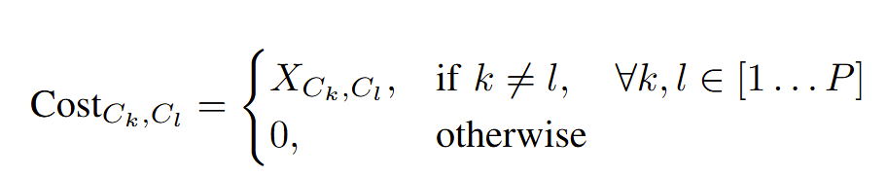
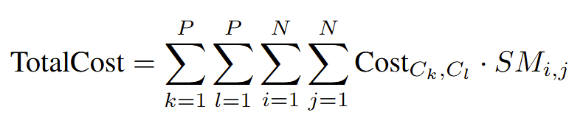
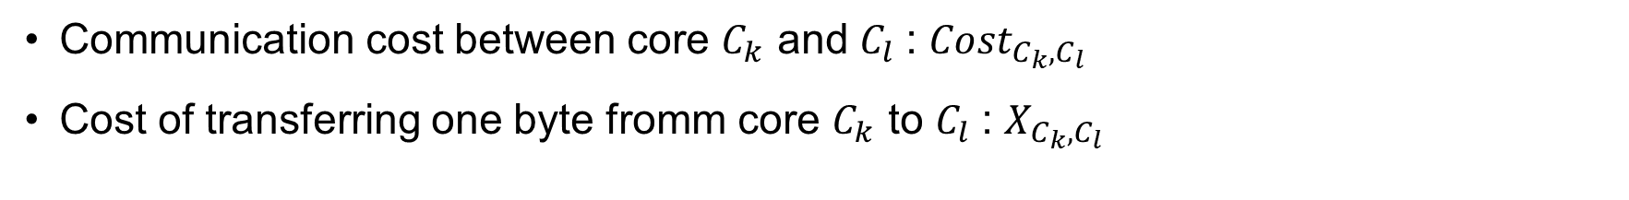
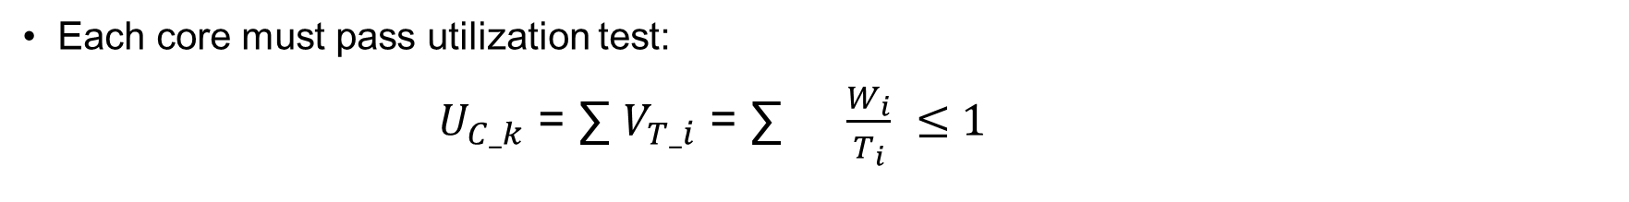
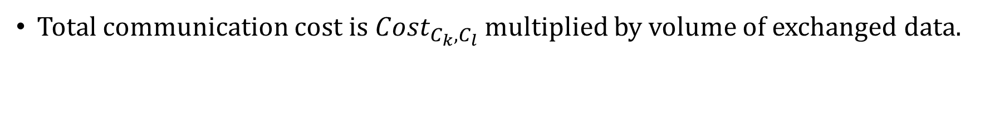
Mathematical Approach
Each core must pass utilization test:
$U_{C_k}$ = ∑ $V_{T_i}$ = ∑ $\frac{W_{i}}{T_{i}}$ ≤ 1
N
N
i = 1
i = 1
Communication cost between core $C_{k}$ and $C_{l}$: ${Cost}_{C_{k},C_{l}}$
Cost of transferring one byte fromm core $C_{k}$ to $C_{l}$: $X_{C_{k},C_{l}}$
Total communication cost is ${Cost}_{C_{k},C_{l}}$ multiplied by volume of exchanged data.

Slide 11
Implementation and Example
Task Number | Execution Time | Period
0 | 1 | 5
1 | 2 | 10
2 | 1 | 4
3 | 2 | 8
4 | 3 | 4
5 | 1 | 10
6 | 5 | 6
Table 1: Task Parameters

Slide 12
Implementation and Example
 | T0 | T1 | T2 | T3 | T4 | T5 | T6
T0 | 0 | 5 | 3 | 9 | 0 | 0 | 0
T1 | 5 | 0 | 4 | 7 | 0 | 0 | 0
T2 | 3 | 4 | 0 | 0 | 0 | 0 | 0
T3 | 9 | 7 | 0 | 0 | 0 | 8 | 0
T4 | 0 | 0 | 0 | 0 | 0 | 0 | 7
T5 | 0 | 0 | 0 | 8 | 0 | 0 | 0
T6 | 0 | 0 | 0 | 0 | 7 | 0 | 0
Table 2: Task dependency matrix

Slide 13
Semi-partitioned Scheduling
Semi-partitioned : Tasks statically assigned to fixed cores.
Semi-Partitioned algorithm
Partitioning algorithm
Scheduling Algorithm
Fig. 4: Parts of semi-partitioned algorithm.

Slide 14
Partitioning Algorithm
Algorithm: Assign Clusters to Cores
1: for each cluster in clusters do
2: Find the least-loaded core that can still take the cluster‘s total utilization.
3: Assign all tasks in the cluster to that core.
4: Update the core‘s utilization.
5: end for
${Cost}_{C_{k},C_{l}}$ = X
$U_{C_k}$ < $U_{C_j}$
Cluster Search
Cluster formed
Assigning Core

Slide 15
Two parts :
Partitioning algorithm: Determines how to split and assign each task to a fixed processor.
Scheduling Algorithm: Determines how to schedule tasks assigned to each processor.
Advantages:
Minimizes communication costs.
Balances load across cores.
Improves system feasiblity.

